Slide 1
EIT x Soft Robots: project update
Week of Monday 16/08/2021

Slide 2
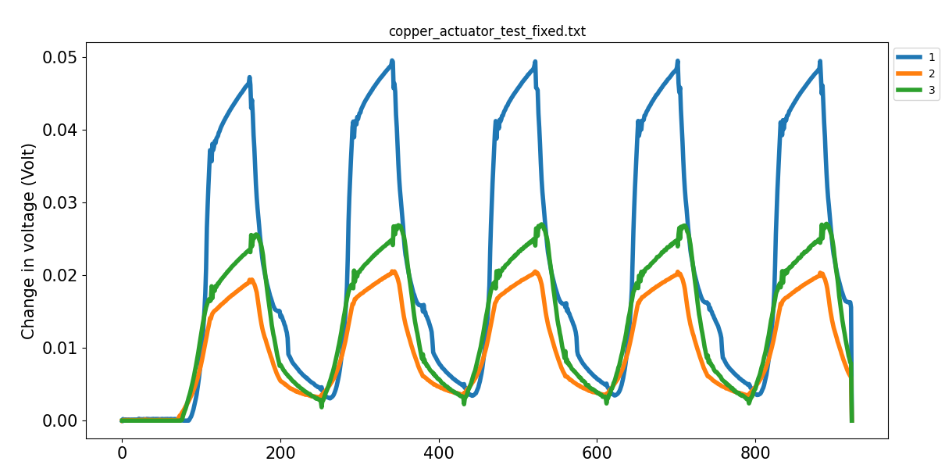
Copper wire actuator data
Time (samples)

Slide 3
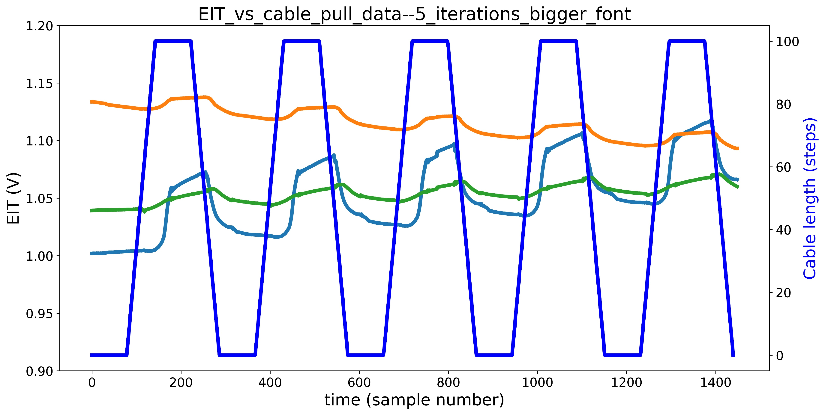
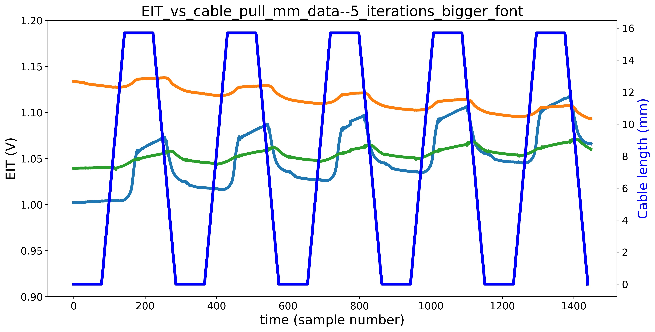
Copper wire actuator data
EIT vs cable pull data
EIT vs cable pull mm data
1
2
3
5 iterations (flex and relax)
50000 sample rate
500 samples taken per triggering
40 Hz triggering from the Arduino (clears up previous issue at 50 Hz)

Slide 4
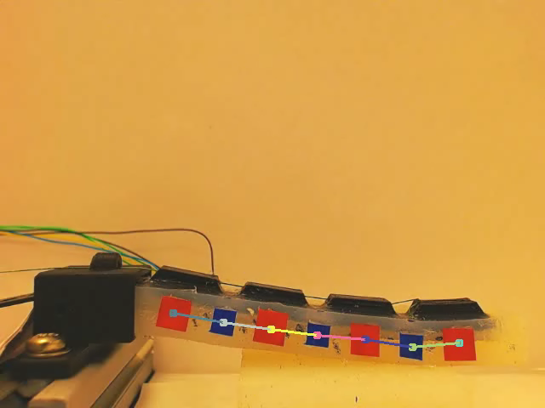
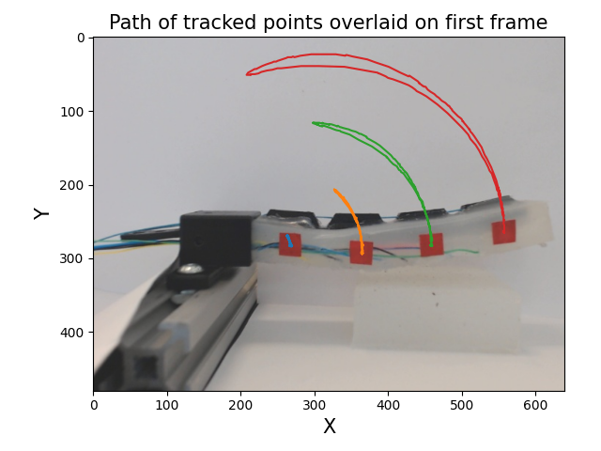
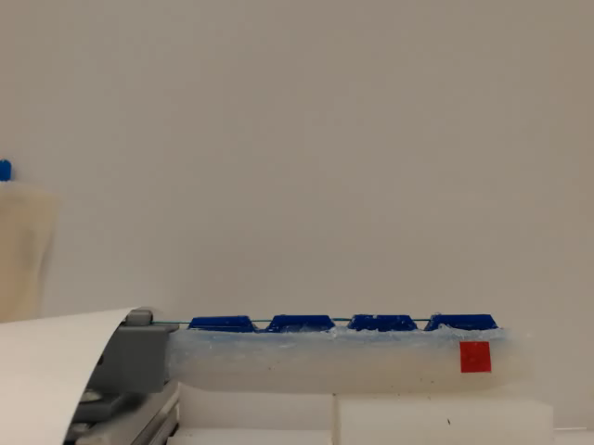
Computer vision progress
Units are pixels

Slide 5
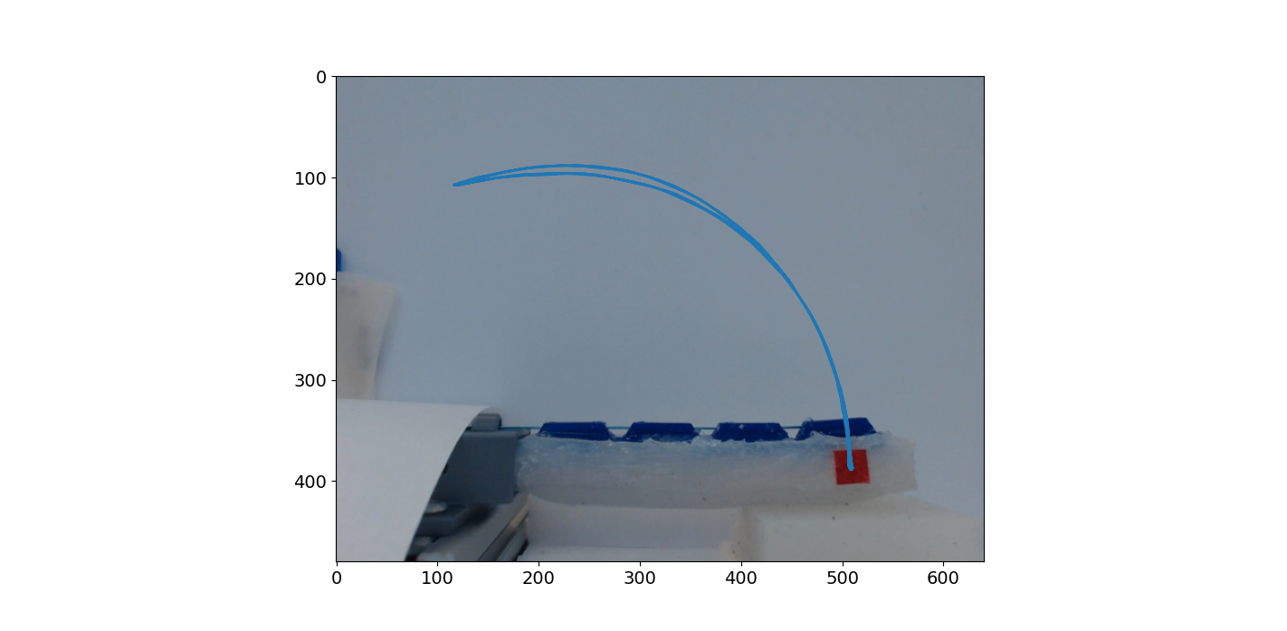
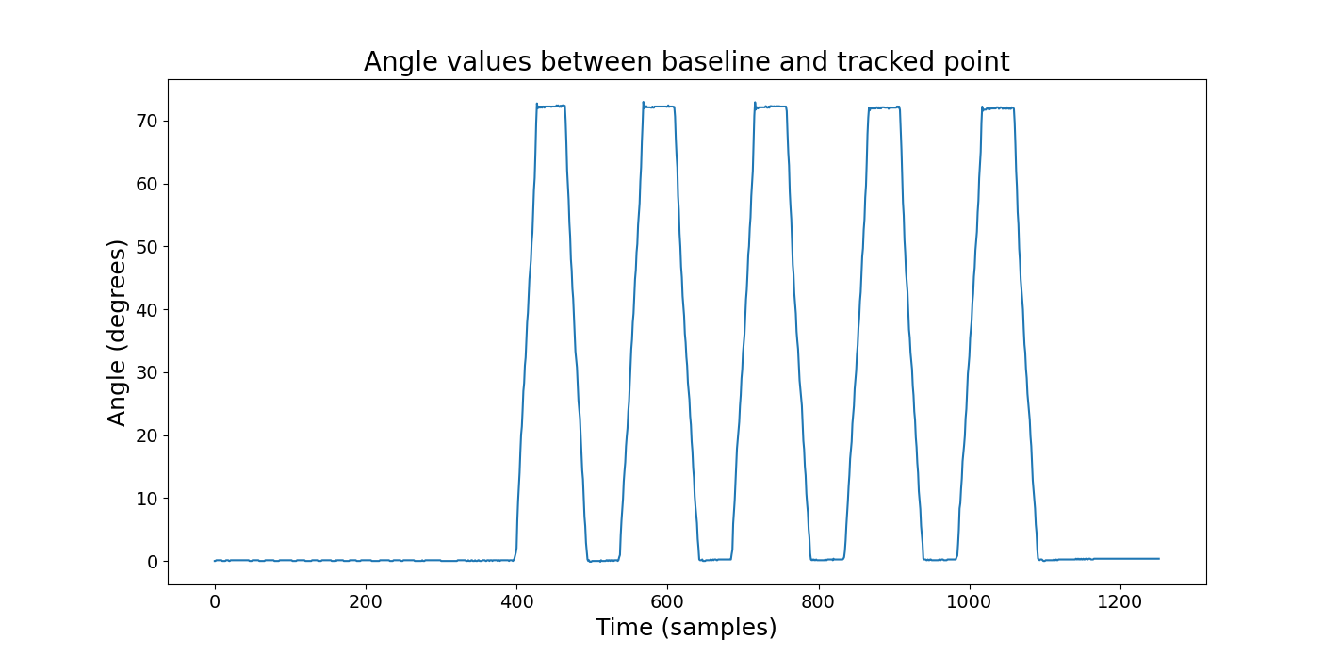
Ground truth acquisition: 1 angle
opp
θ
adj

Slide 6
TODO
Questions
Refine pipeline for acquiring data (from DAQ, Arduino, and webcam)
Refine pipeline for collating and aligning data (must fix Git error)
Feed data into ML script (start simple with linear regression, also develop LSTM)
Actual thesis writing
What changes (if any) are appropriate to my figures to make them suitable for the thesis?
Feedback on thesis structure
What limit is there (if any) on images in the thesis?
Any concrete feedback on the literature review?

